Slide 1
Argonaut: Macrotask Crowdsourcing for Complex Data Processing
Daniel Haas*, Jason Ansel§,
Lydia Gu§, Adam Marcus^{Ŧ}
*AMPLab, UC Berkeley
§GoDaddy, Inc.
^{Ŧ}Unlimited Labs, Inc.
VLDB 2015

Slide 2
Outline
Microtasks and Macrotasks
Argonaut: high-quality macrotasks with:
Hierarchical worker organization
Predictive quality control
Worker modeling to identify good workers
Evaluation
Real-world lessons from GoDaddy

Slide 3
Outline
Microtasks and Macrotasks
Argonaut: high-quality macrotasks with:
Hierarchical worker organization
Predictive quality control
Worker modeling to identify good workers
Evaluation
Real-world lessons from GoDaddy

Slide 4
Traditional knowledge work

Slide 5

Traditional knowledge work

Slide 6

Traditional knowledge work

Slide 7
Traditional knowledge work is
complex, rich, collaborative
But also
expensive, hard to scale
And
cannot automate quality control

Slide 8
Microtasks

Slide 9


Microtasks
YES
NO

Slide 10
Microtasks
Simple, short, robotic
CrowdDB, Deco, Qurk,
Corleone, CrowdER,
DataTamer, …
YES
NO

Slide 11


Microtasks
Simple, short, robotic
CrowdDB, Deco, Qurk,
Corleone, CrowdER,
DataTamer, …
YES
NO

Slide 12
Microtasks
Simple, short, robotic
CrowdDB, Deco, Qurk,
Corleone, CrowdER,
DataTamer, …
YES
NO
Quality control: voting
Y Y Y N Y
Y
(2% error)

Slide 13
Microtasks
Simple, Short, Robotic
What you think when you hear ‘crowdsourcing’
CrowdDB, Deco, Qurk,
Corleone, CrowdER,
DataTamer, …
YES
NO
Quality Control: Voting
Y Y Y N Y
Y
(2% error)

Slide 14
Microtasks are
simple, scalable, inexpensive
But also
dehumanizing
And sometimes
a poor fit for the work

Slide 15
What do you mean, a poor fit?

Slide 16
GoDaddy’s data extraction problem

Slide 17
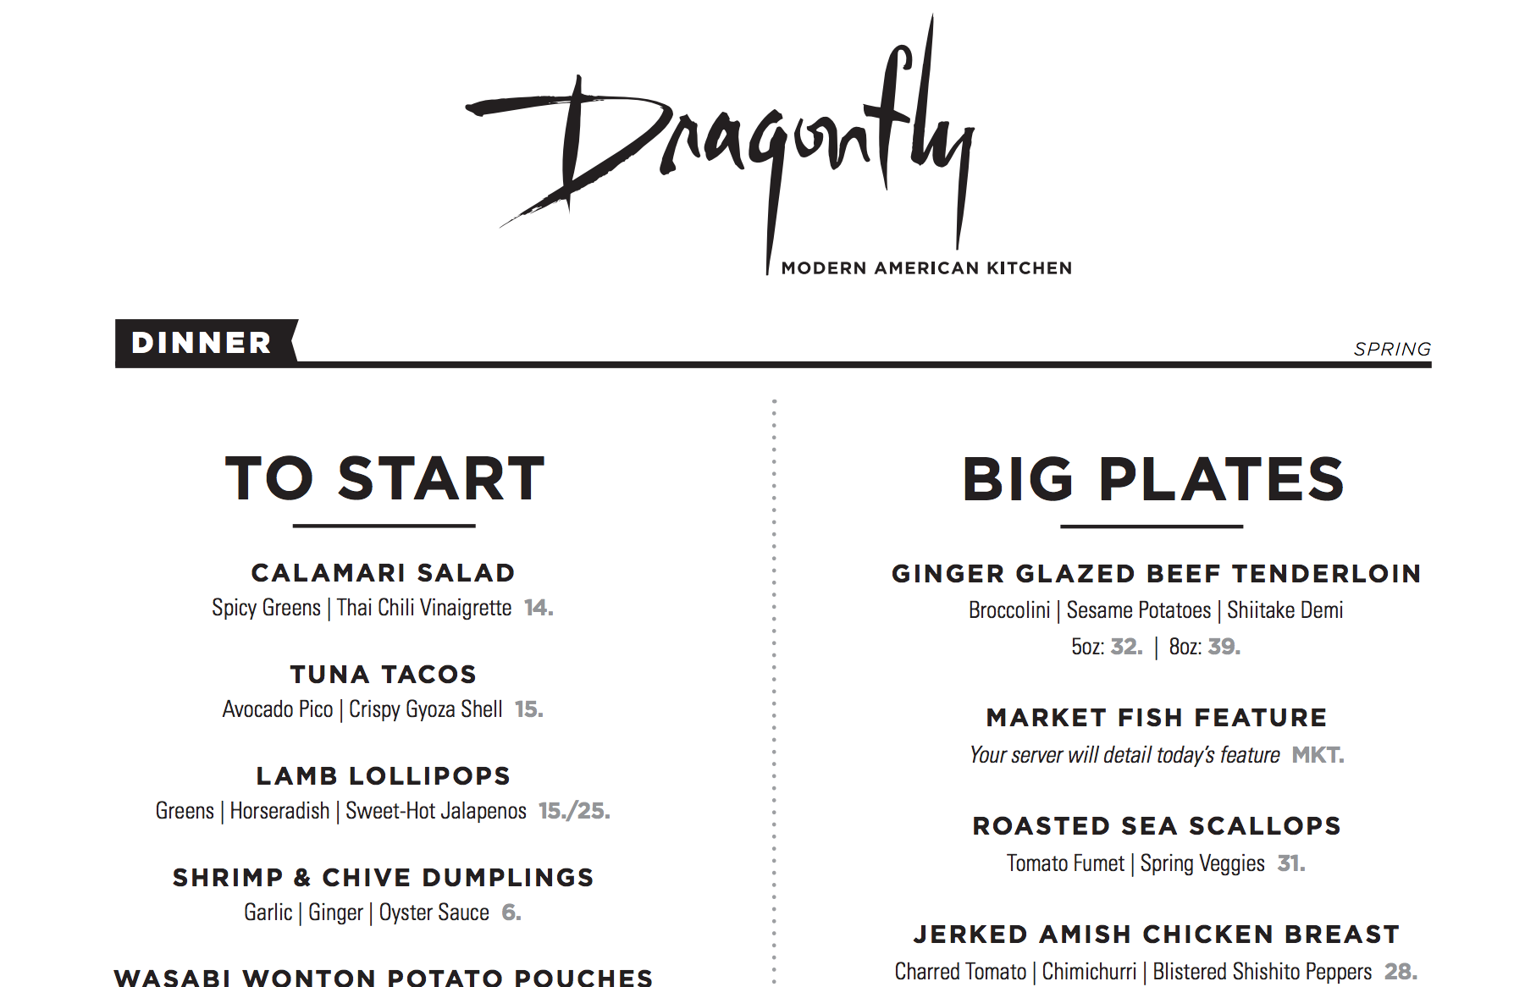
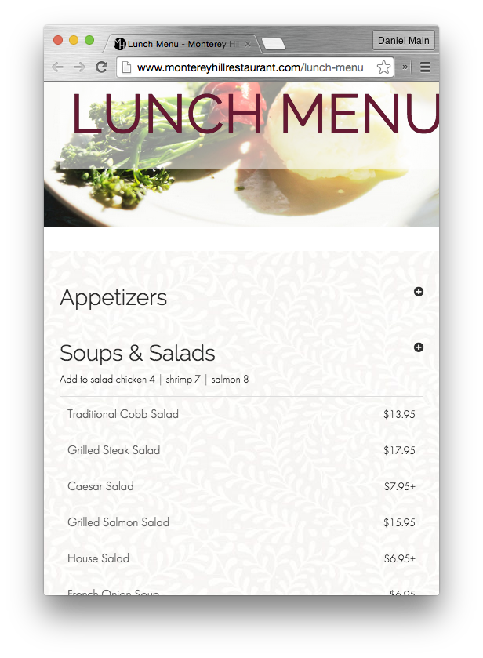
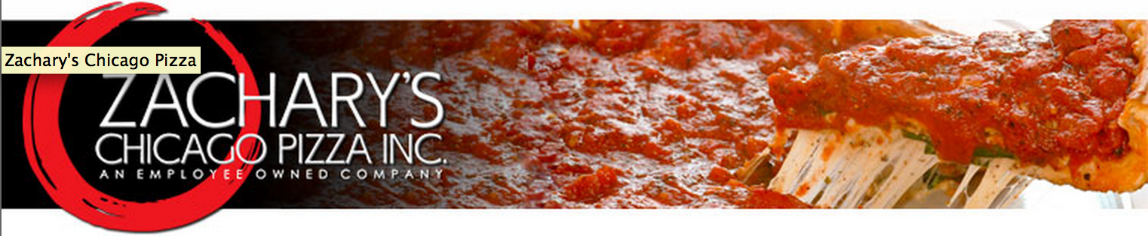
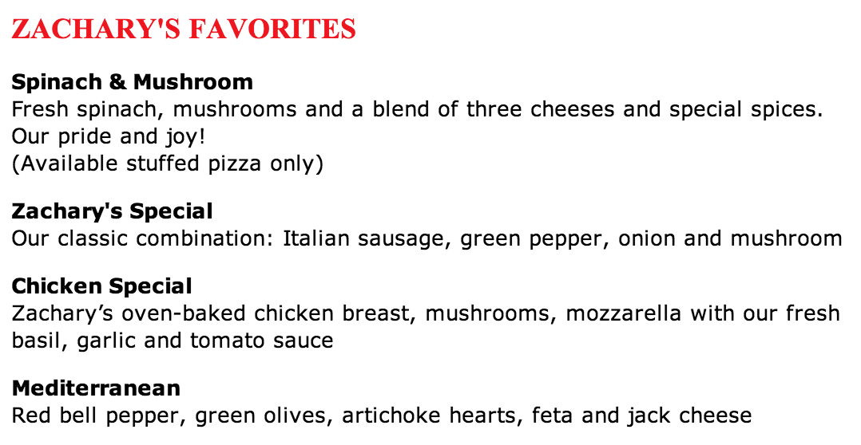
GoDaddy’s data extraction problem

Slide 18
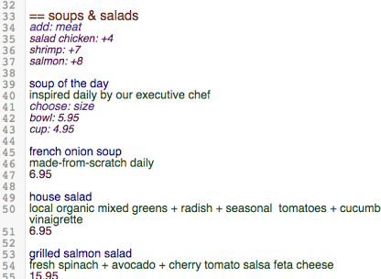
GoDaddy’s data extraction problem

Slide 19





GoDaddy’s data extraction problem

Slide 20
GoDaddy’s data extraction problem

Slide 21
GoDaddy’s data extraction problem
Complex work

Slide 22
GoDaddy’s data extraction problem
Complex work

Slide 23
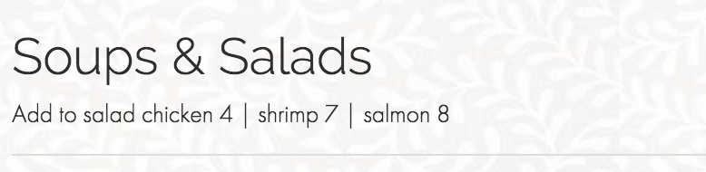
GoDaddy’s data extraction problem
Complex work
Context sensitive

Slide 24
GoDaddy’s data extraction problem
Complex work
Context sensitive

Slide 25
GoDaddy’s data extraction problem
Complex work
Context sensitive
Complex output

Slide 26
GoDaddy’s data extraction problem
Complex work
Context sensitive
Complex output

Slide 27
Design philosophy
Microtasks
Scalable
Inexpensive
Automated

Slide 28
Design philosophy
Microtasks
Knowledge work
Scalable
Inexpensive
Automated
Complex
Meaningful
Interactive

Slide 29
Design philosophy
Microtasks
Knowledge work
Scalable
Inexpensive
Automated
Complex
Meaningful
Interactive
= Macrotasks

Slide 30
Outline
Microtasks and Macrotasks
Argonaut: high-quality macrotasks with:
Hierarchical worker organization
Predictive quality control
Worker modeling to identify good workers
Evaluation
Real-world lessons from GoDaddy

Slide 31

Requester
Incoming tasks
Finalized tasks

Slide 32
Requester
Incoming tasks
Finalized tasks
TaskGrader model
Tasks with assigned hierarchy level
Task manager

Slide 33
Requester
Incoming tasks
Finalized tasks
TaskGrader model
Worker model
Hierarchy
Tasks with assigned hierarchy level
Task router
Task manager
Worker manager

Slide 34
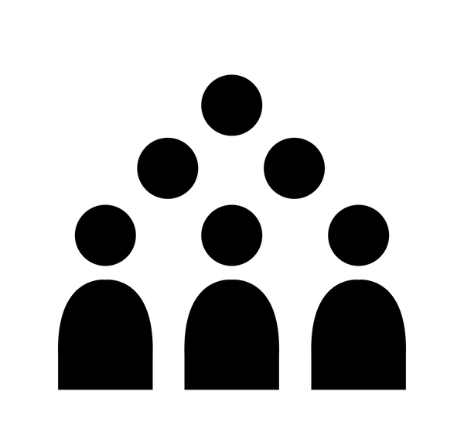
Requester
Crowd
Incoming tasks
Finalized tasks
Completed
tasks
Requested
tasks
Crowd responses
TaskGrader model
Worker model
Hierarchy
Tasks with assigned hierarchy level
Task router
Task manager
Worker manager

Slide 35
1. Hierarchical worker organization

Slide 36
A hierarchy of review
Data entry specialists

Slide 37
A hierarchy of review
Reviewers
Feedback
Work
Data entry specialists

Slide 38
A hierarchy of review
Top-tier reviewers
Feedback
Work
Reviewers
Feedback
Work
Data entry specialists

Slide 39
A hierarchy of review
Qualitative
feedback and administration
Top-tier reviewers
Feedback
Manager
Work
Reviewers
Feedback
Work
Data entry specialists

Slide 40
A hierarchy of review
Qualitative
feedback and administration
Top-tier reviewers
Worker model
Feedback
Manager
Work
Promotions
Demotions
Reviewers
Feedback
Work
Data entry specialists

Slide 41
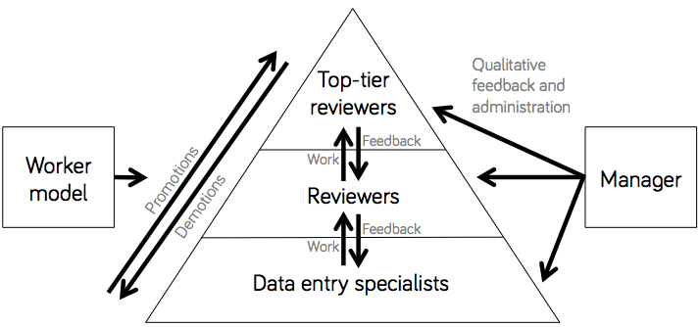
A hierarchy of review
Benefits:
Good workers get more responsibility/reward

Slide 42
A hierarchy of review
Benefits:
Good workers get more responsibility/reward
Good workers train untrusted workers

Slide 43
A hierarchy of review
Benefits:
Good workers get more responsibility/reward
Good workers train untrusted workers
Managers reduce burden

Slide 44
A hierarchy of review
Benefits:
Good workers get more responsibility/reward
Good workers train untrusted workers
Managers reduce burden
Treats workers like people!

Slide 45
2. Predictive quality control

Slide 46

Challenge: fixed review budget

Slide 47
Challenge: fixed review budget
Solution: don’t review everything

Slide 48
Challenge: which tasks to review?

Slide 49
Challenge: which tasks to review?
Insight: not all tasks have errors!

Slide 50
Challenge: which tasks to review?
Insight: not all tasks have errors!
Solution: the TaskGrader
Predictive regression: how error-prone is a submitted task?
Threshold and review only the high-error tasks

Slide 51
Features: what makes a task bad?
Notes:
Task-specific, generalizable tasks do well
Money-number: up to 118% more errors than random w/ same budget

Slide 52
Features: what makes a task bad?
> 1k engineered features
Notes:
Task-specific, generalizable tasks do well
Money-number: up to 118% more errors than random w/ same budget

Slide 53
Features: what makes a task bad?
> 1k engineered features
Generalizable (duration spent on task, time of day, past worker performance)
vs
Domain-specific (# of items in menu, # of spelling errors, automated sanity checks)
Notes:
Task-specific, generalizable tasks do well
Money-number: up to 118% more errors than random w/ same budget

Slide 54
3. Worker modeling

Slide 55
Why model workers?

Slide 56
Why model workers?
Train and incentivize
low-performing workers

Slide 57
Why model workers?
Train and incentivize
low-performing workers
Promote
high-performing workers

Slide 58
How do we model them?
A simple weighted average of

Slide 59
How do we model them?
A simple weighted average of
accuracy: 75%ile error score

Slide 60
How do we model them?
A simple weighted average of
accuracy: 75%ile error score
speed: average task duration

Slide 61
Outline
Microtasks and Macrotasks
Argonaut: high-quality macrotasks with:
Hierarchical worker organization
Predictive quality control
Worker modeling to identify good workers
Evaluation
Real-world lessons from GoDaddy

Slide 62
running for 3 years

Slide 63
over a million tasks

Slide 64
over half a million hours of
human contribution

Slide 65
Key Questions
Does review improve task quality?
Does review save time over redundancy?
How well does the TaskGrader predict error?
How generalizable is the TaskGrader?

Slide 66
Does review improve task quality?
Two authors participated in a blind test where they looked at 2 versions of a task and selected the improved version:
review improved quality in most tasks
80%
For 71 tasks
70%
60%
40%
20%
20%
10%
Improved
No change
Worsened

Slide 67
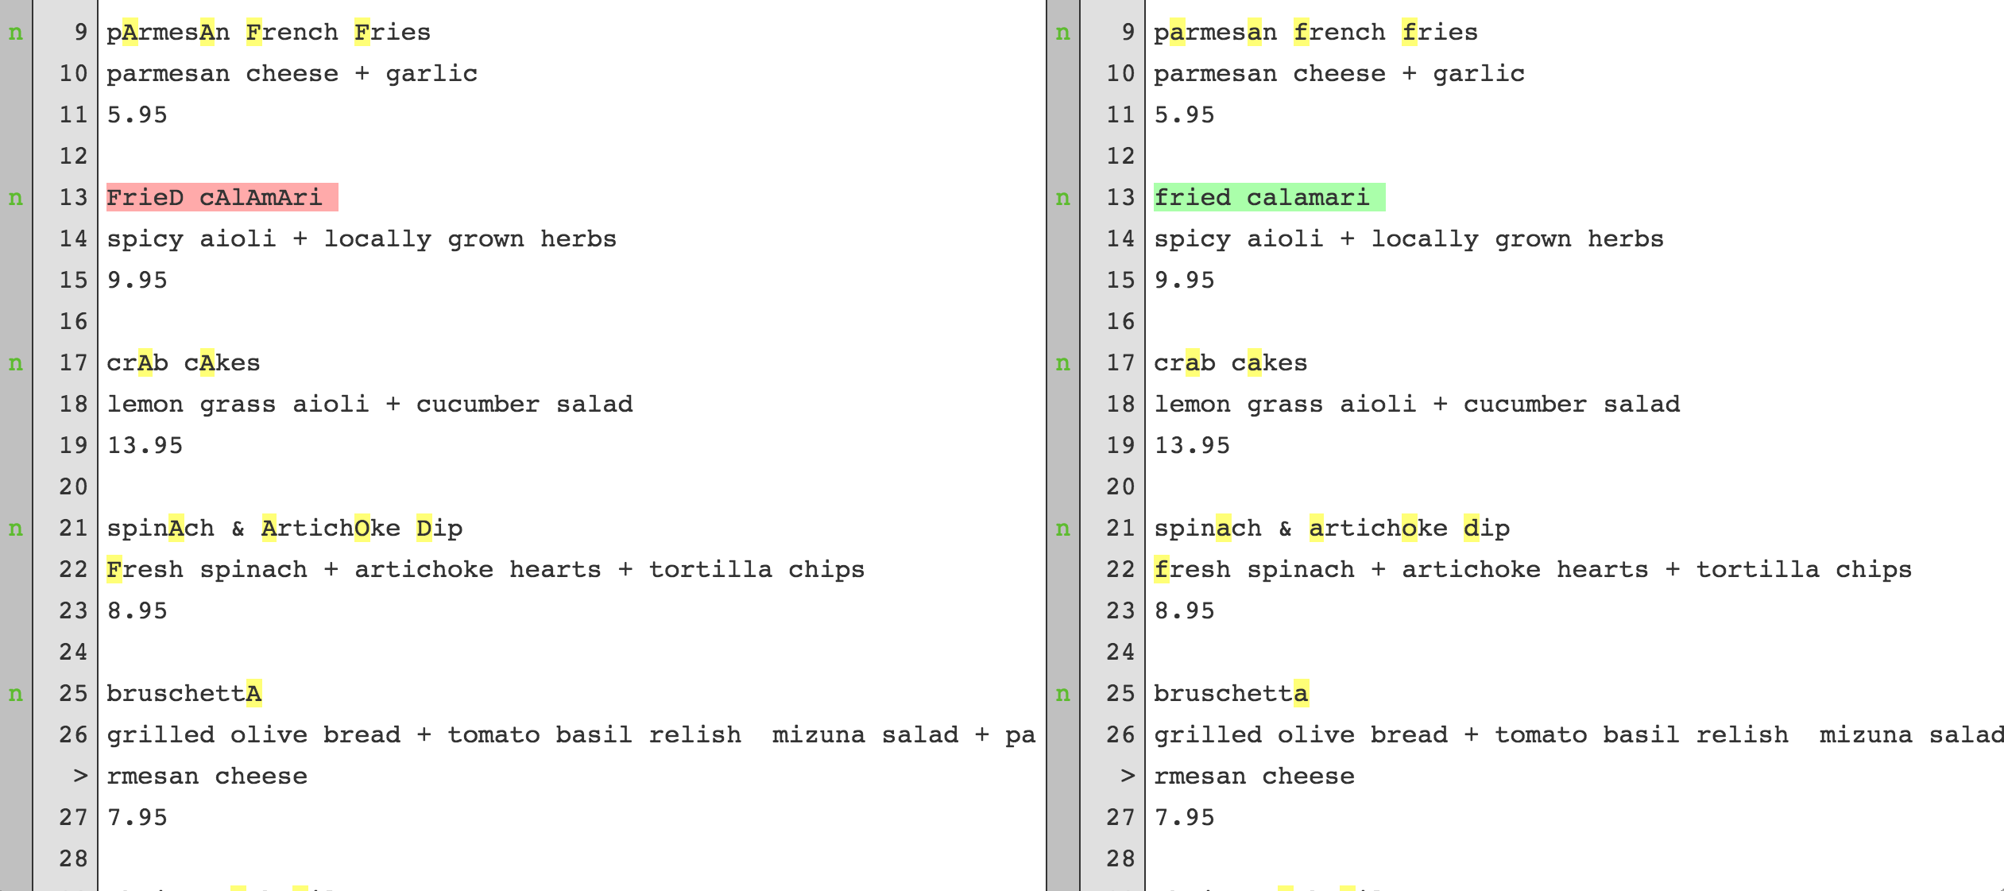
Does review improve task quality?
Data entry specialist output
Reviewer output

Slide 68
Does review save time over redundancy?
10000
Red line represents the median.
Box represents the 25 to 75th percentiles.
Whiskers represent 5 and 95th percentiles.
8000
6000
Time (seconds)
4000
2000
Processing
Review 1
Review 2
review takes much less time than processing

Slide 69
Key Questions
Does review improve task quality?
Does review save time over redundancy?
How well does the TaskGrader predict error?
How generalizable is the TaskGrader?

Slide 70
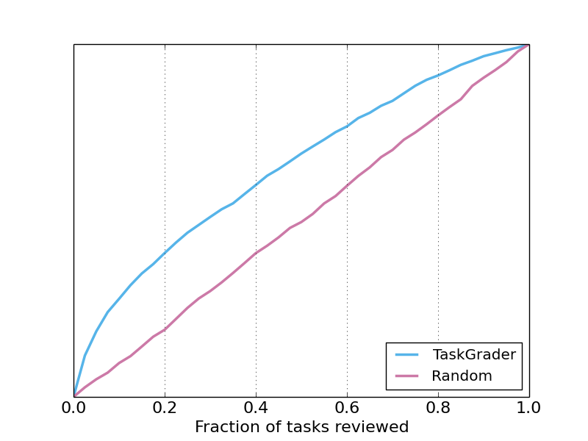
How well does the TaskGrader predict error?
% errors caught

Slide 71
How well does the TaskGrader predict error?
% errors caught
Catches 50% more errors than random.

Slide 72
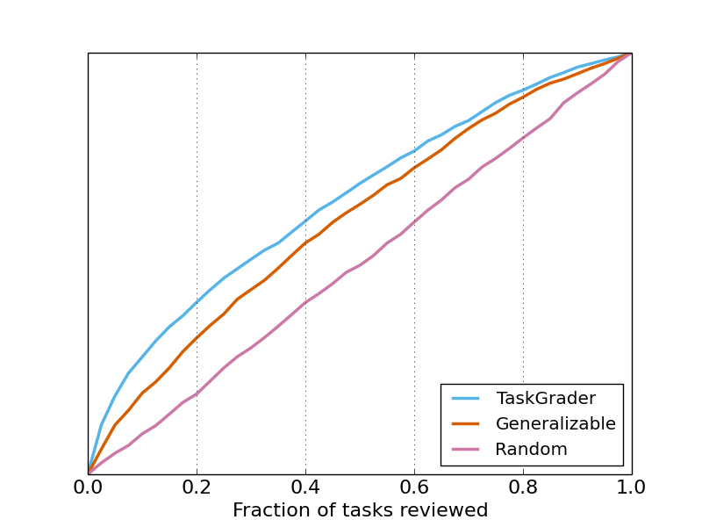
How generalizable is the TaskGrader?
% errors caught
Catches 35% more errors than random.

Slide 73
Outline
Microtasks and Macrotasks
Argonaut: high-quality macrotasks with:
Hierarchical worker organization
Predictive quality control
Worker modeling to identify good workers
Evaluation
Real-world lessons from GoDaddy

Slide 74
throughput is neither constant nor consistent
Notes:
People in an agency talk to each other. They probably are not working completely within your software system.

Slide 75
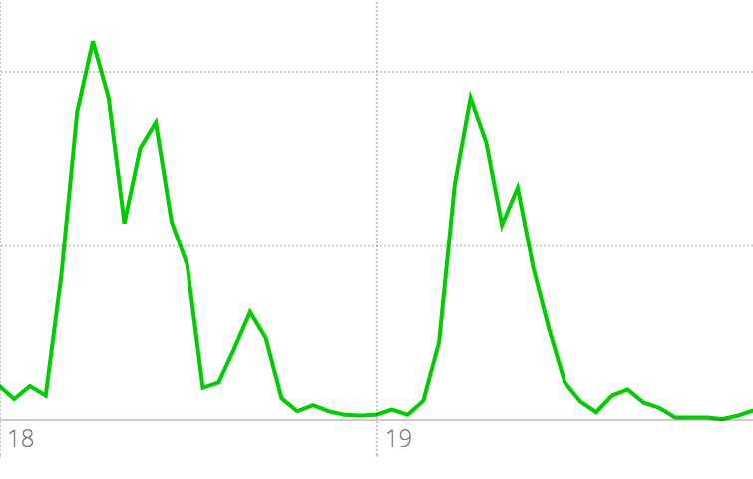
tasks completed per hour
tueday
wednesday
time
constant throughput doesn’t come for free

Slide 76
tackling English-language barriers
Notes:
Both literally and culturally

Slide 77
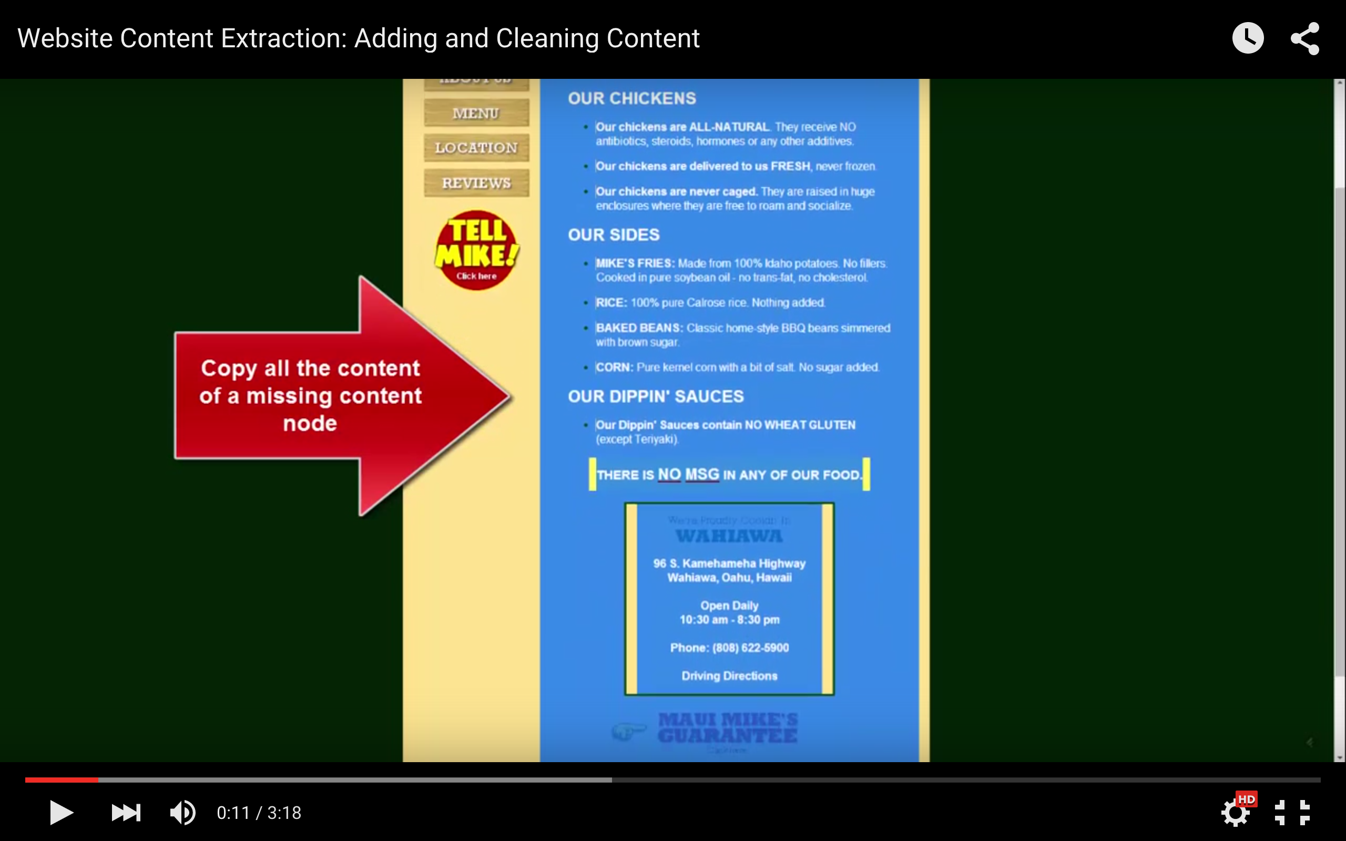
written English easier than spoken English: instructions via video popups instead of audio
Notes:
Both literally and culturally

Slide 78
bootstrapping a crowd hierarchy takes time

Slide 79

full-time employee
User by Cees de Vries from the Noun Project

Slide 80
full-time employee
User by Cees de Vries from the Noun Project

Slide 81
full-time employee
User by Cees de Vries from the Noun Project

Slide 82
full-time employee
documentation helps
videos help
still need synchronous training sessions to answer questions
User by Cees de Vries from the Noun Project

Slide 83
people interact outside of your software systems
Notes:
People in an agency talk to each other. They probably are not working completely within your software system.

Slide 84
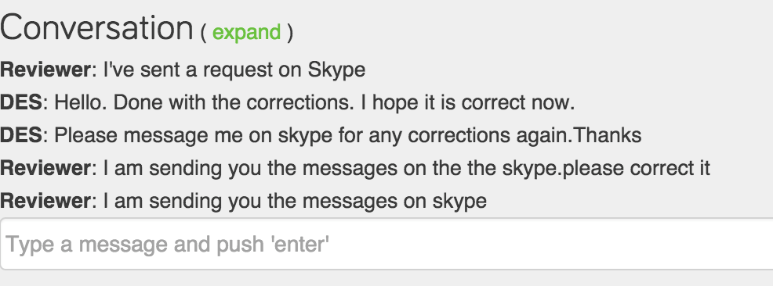
your statistics might be lying to you
understand what’s happening outside your system

Slide 85
task-specific features
>>
worker-specific features

Slide 86
Thanks!
Argonaut: a framework for
quality macrotasks
with worker hierarchies
and automated quality control
Thanks to the great team at GoDaddy and the ~300 crowd workers who made this work possible!
We’re hiring! Visit us @ careers.godaddy.net

Slide 87
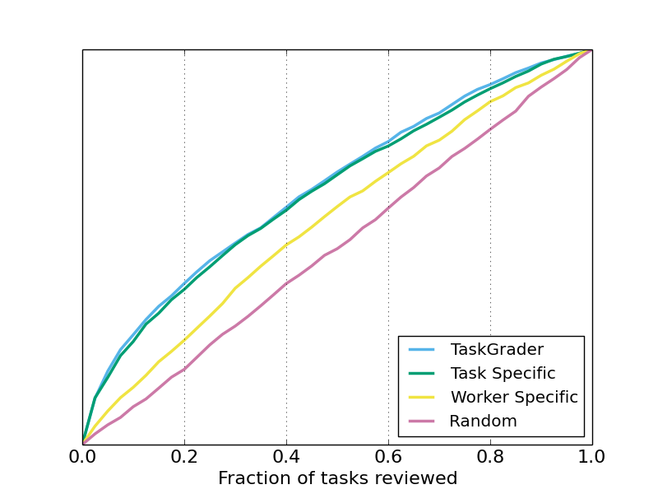
worker-specific vs. task-specific features
task quality

Slide 88
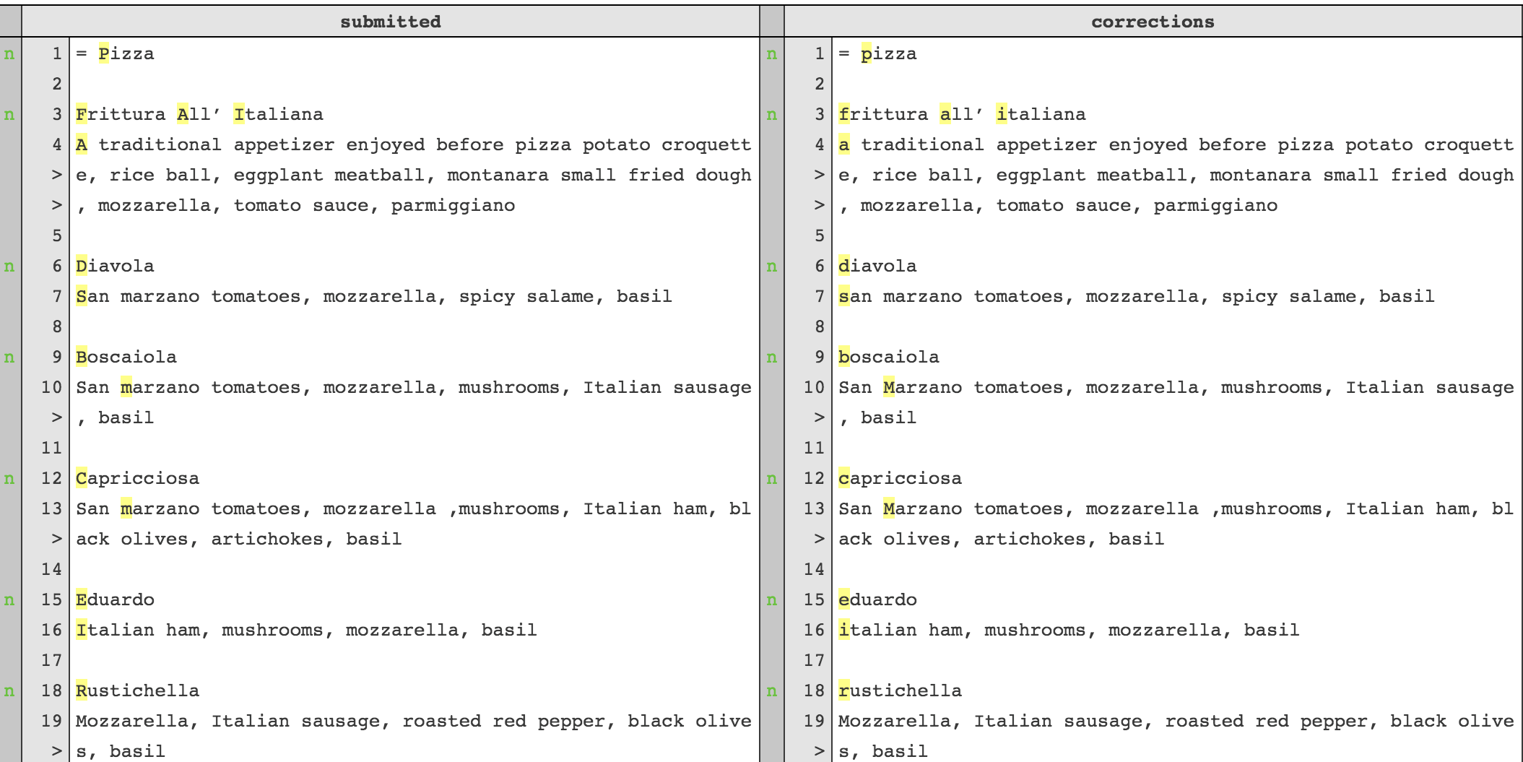
Does review improve task quality?

